Slide 1
King and Williams et al., Figure 3. Intestine expression filtering

Slide 2
Datasets
Dataset | Stage | DOI | Detail | Seq method
Tintori et al., 2016 | Early Embryo (2Ep cell) | http://doi.org/10.1016/j.devcel.2016.07.025 | Single cell RNA-seq of hand dissected embryo. Accessed from tintori.bio.unc.edu. | Illumina
Hashimshony et al., 2015 | Embryo | http://doi.org/10.1038/nature13996 | Supplementary Table 4. Endoderm gene set from Single cell RNA-seq of cultured dissociated embryos. | Illumina
Pauli et al., 2006 | L4 | http://doi.org/10.1242/dev.02185 | Supplementary Table 1. Microarray of ges-1P::PAB-1 pulldown in L4 worms | Microarray
Spencer et al., 2010 | Late Embryo | http://doi.org/10.1101/gr.114595.110 | FACS Sorted ELT-2::GFP worms. https://www.vanderbilt.edu/wormdoc/wormmap | Microarray
Spencer et al., 2010 | L2 | http://doi.org/10.1101/gr.114595.110 | FACS Sorted ELT-2::GFP worms. https://www.vanderbilt.edu/wormdoc/wormmap | Microarray

Slide 3
Published Data Parameters
Dataset | Stage |  | Published Filtering
Tintori et al., 2016 | Early Embryo (2Ep cell) | Log2(Counts per million), log2(Fold Change), adjusted p-value | NA
Hashimshony et al., 2015 | Embryo | None, a list of “endoderm genes” | “At least two-thirds of its expression in that germ layer”
Pauli et al., 2006 | L4 | Percentile rank (Cy5/Cy3 ratios), p-value | Percentile > 0.6, p-value < 0.001
Spencer et al., 2010 | Late Embryo, L2 | AveExpr = the normalized log2 intensity value from the 3 replicate microarrays for that particular cell-type t = the t value from the moderated t-test used to determine statistically significant differential expression P_Value = the raw P-value from the t-test adj_P_Val = the False Discovery Rate used to correct for multiple testing FC = the linear fold change of the expression value for that gene vs. the expression value in the reference | Fold Change > 2x, FDR < 5%

Slide 4
Filtering 1
Dataset | Stage | Filtering | Number of genes
Tintori et al., 2016 | Early Embryo (2Ep cell) | Log2(FC) > 1, p adj < 0.05 | 610
Hashimshony et al., 2015 | Embryo | Present in list | 372
Pauli et al., 2006 | L4 | Percentile > 0.6, p-value < 0.001 | 1630
Spencer et al., 2010 | Late Embryo | Fold Change > 2x, FDR < 5% | 880
Spencer et al., 2010 | L2 | Fold Change > 2x, FDR < 5% | 940

Slide 5
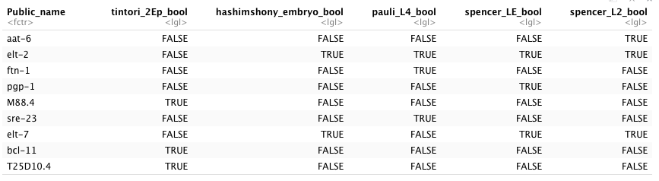
Filtering 1: smFISH Genes

Slide 6
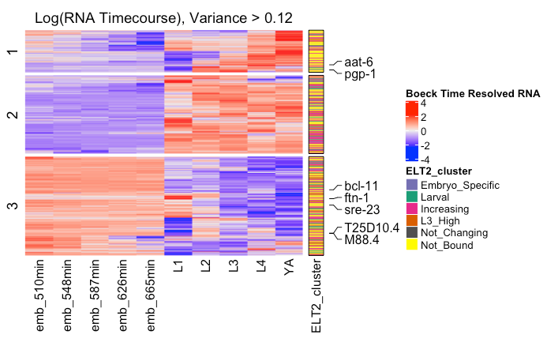
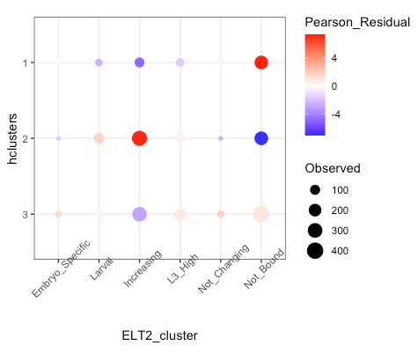
Filtering 1 downstream analysis
Time-resolved RNA heatmap
ELT-2 binding mosaic plot

Slide 7
Filtering 2
Dataset | Stage | Filtering | Number of genes
Tintori et al., 2016 | Early Embryo (2Ep cell) | Log2(FC) > 5, p adj < 0.05 | 238
Hashimshony et al., 2015 | Embryo | Present in list | 372
Pauli et al., 2006 | L4 | Percentile > 0.8, p-value < 0.001 | 1341
Spencer et al., 2010 | Late Embryo | Fold Change > 5x, FDR < 5% | 154
Spencer et al., 2010 | L2 | Fold Change > 5x, FDR < 5% | 32

Slide 8
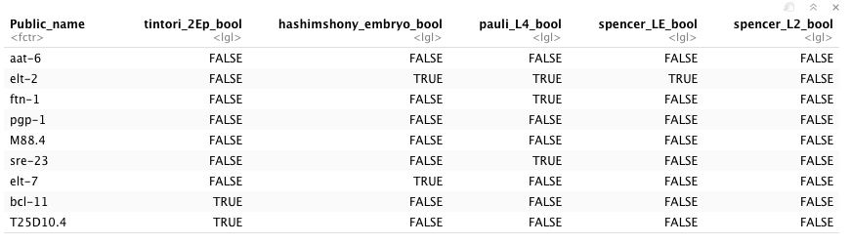
Filtering 2: smFISH Genes
Filtering 2 removes aat-6, pgp-1, M88.4

Slide 9
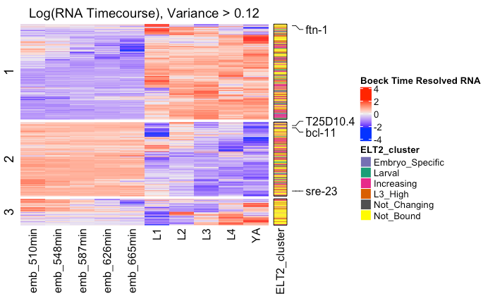
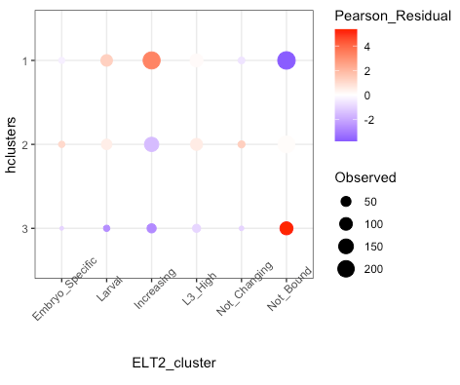
Filtering 2 downstream analysis
Time-resolved RNA heatmap
ELT-2 binding mosaic plot

Slide 10
Filtering 3
Dataset | Stage | Filtering | Number of genes
Tintori et al., 2016 | Early Embryo (2Ep cell) | Log2(FC) > 8, p adj < 0.05 | 70
Hashimshony et al., 2015 | Embryo | Present in list | 372
Pauli et al., 2006 | L4 | Percentile > 0.9, p-value < 0.001 | 615
Spencer et al., 2010 | Late Embryo | Fold Change > 8x, FDR < 5% | 18
Spencer et al., 2010 | L2 | Fold Change > 6x, FDR < 5% | 10

Slide 11
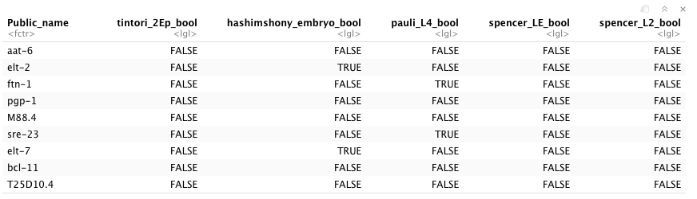
Filtering 3: smFISH Genes
Filtering 2 removes aat-6, pgp-1, M88.4, bcl-11 and T25D10.4

Slide 12
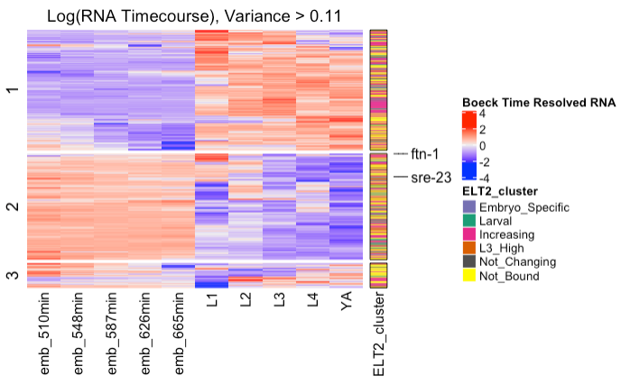
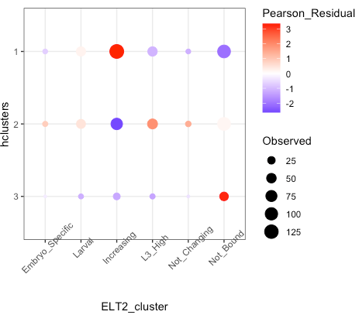
Filtering 3 downstream analysis
Time-resolved RNA heatmap
ELT-2 binding mosaic plot

Slide 13
210610: Changes to genes included in analysis
Time-resolved RNA-seq genes (19,918 genes)
Intestine expressed genes (2,901 genes)
Genes with a single ELT-2 occupancy type (1,368 genes)
Genes with 95% highest variance (1,212 genes)

Slide 14
Exploration of Time-resolved RNA data
Above is the distribution of expression values for each gene in each sample (dcpm, depth of coverage per base per million reads). A majority are near zero.
Log10 transformation makes the expression values appear normally distributed.

Slide 15
Time resolved RNA: A majority of genes have a variance less than 2
Row-wise variances were calculated for each gene across the developmental time series.
Genes with the lowest 5% variance were removed from the next analysis
Is 5% enough?
Should a hard cutoff be used instead, like 1?
5% cutoff = 0.039
1368 genes -> 1212 genes

Slide 16
Distribution of log transformed expression values for genes with highest 95% variance in all samples
This is before the 5% cutoff
Doesn’t look that different than before removing lowest 5%
These log transformed values are then scaled using a Z-score

Slide 17
210610 Data output
Scree plot suggests two clusters now instead of three
Heatmap appears to have “embryonic” and
“post-embryonic” clusters

Slide 18
210610 Next steps
Include additional intestine datasets:
Blaize et al 2015, mixed stage PAT-seq, Mangone lab
Haenni et al, mixed stage FANS
Cao et al 2017, L2 sciRNA-seq
Anything else?
Time-resolved gene expression analysis
0 to 1 row scaling of gene expression level instead of z score? This is what Max used in his paper
Variance cutoff? Makes more sense than a lowest percentage cutoff…
What is an acceptable cutoff value?
Should we even remove genes this way?
Minimum expression value (dcpm) cutoff? Max required gene dcpm > 0.07 in at least one stage

